Slide 1

2018 Seminar on Predictive Modeling:
Mixed Models
Jeffrey Strickland, Ph.D., CMSP, ASEP
CEO Humalytica Analytics
Proprietor Simulation Educators

Slide 2
KNIME Models
This KNIME Example Workflow uses a File Reader node to import the Iris dataset (included).
It then assigns visual properties with a Color Manager node and computes some basic statistics with a Statistics node.
The data is split into training and testing fractions with a Partitioning node using a 60/40 split.
The Decision Tree Learner generates a predictive model in PMML from the training fraction which is then applied to the test fraction using the Decision Tree Predictor.
Model performance is evaluated with Scorer nodes, which is applied after the Decision Tree Predictor.
Finally, errors can be explored interactively, by using an Interactive Table node to highlight certain classes of errors which can then be visualized using a Scatter Plot node.
The data is also split into training and testing fractions with a Partitioning node using a 50/50 split.
The Naïve Bayes Learner generates a predictive model in PMML from the training fraction which is then applied to the test fraction using the Naïve Bayes Predictor.
Model performance is evaluated with Scorer node, which is applied after the Naïve Bayes Predictor.
Finally, errors can be explored interactively, by using an Interactive Table node to highlight certain classes of errors which can then be visualized using a Scatter Plot node.
In our case, we examine the Confusion Matrix of each model.

Slide 3
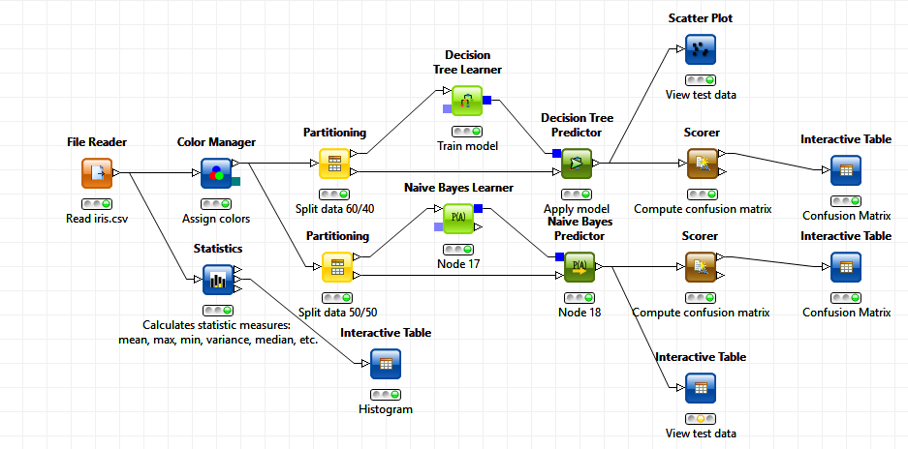
KNIME Model Comparison

Slide 4
Model Comparison – Two Models
Confusion Matrix
Classification Tree Model
row ID | Yes | No
Yes | 29 | 84
No | 40 | 210
Naïve Bayes Model
row ID | Yes | No
Yes | 16 | 107
No | 53 | 277

Slide 5
Model Comparison – Two Models
Accuracy Statistics Table
Classification Tree Model
row ID | TruePositives | FalsePositives | TrueNegatives | FalseNegatives | Recall | Precision | Sensitivity | Specifity | F-measure | Accuracy
Yes | 29 | 40 | 210 | 84 | 0.25664 | 0.42029 | 0.256637 | 0.84 | 0.318681
No | 210 | 84 | 29 | 40 | 0.84 | 0.714286 | 0.84 | 0.256637 | 0.772059
Overall |  |  |  |  |  |  |  |  |  | 0.658402
Naïve Bayes Model
row ID | TruePositives | FalsePositives | TrueNegatives | FalseNegatives | Recall | Precision | Sensitivity | Specifity | F-measure | Accuracy
Yes | 16 | 53 | 277 | 107 | 0.13001 | 0.231884 | 0.130081 | 0.839394 | 0.166667
No | 277 | 107 | 16 | 53 | 0.83934 | 0.721354 | 0.839394 | 0.130081 | 0.77591
Overall |  |  |  |  |  |  |  |  |  | 0.646799

Slide 6
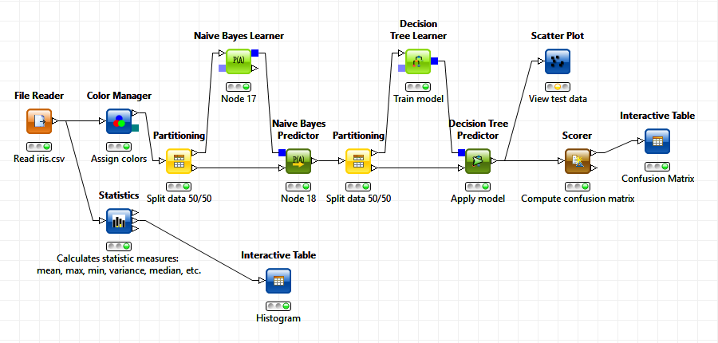
KNIME Mixed Model
Output
Input

Slide 7
Mixed Model Results
Confusion Matrix
Mixed Model
row ID | Yes | No
Yes | 5 | 72
No | 6 | 144
Accuracy Statistics Table
Mixed Model
row ID | TruePositives | FalsePositives | TrueNegatives | FalseNegatives | Recall | Precision | Sensitivity | Specifity | F-measure | Accuracy
Yes | 5 | 6 | 144 | 72 | 0.06496 | 0.454545 | 0.064935 | 0.96 | 0.113636
No | 144 | 72 | 5 | 6 | 0.96 | 0.666667 | 0.96 | 0.064935 | 0.786885
Overall |  |  |  |  |  |  |  |  |  | 0.656388

Slide 8
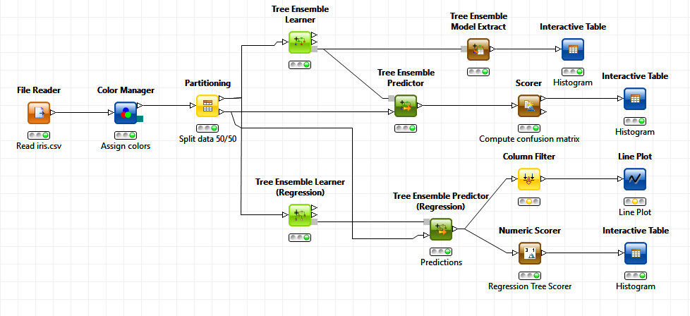
KNIME Ensemble Model

Slide 9
Ensemble Model Results
Confusion Matrix
Ensemble Model
row ID | Yes | No
Yes | 10 | 82
No | 33 | 238
Accuracy Statistics Table
Ensemble Model
row ID | TruePositives | FalsePositives | TrueNegatives | FalseNegatives | Recall | Precision | Sensitivity | Specifity | F-measure | Accuracy
Yes | 10 | 33 | 238 | 82 | 0.10870 | 0.232558 | 0.108696 | 0.878229 | 0.148148
No | 238 | 82 | 10 | 33 | 0.87823 | 0.74375 | 0.878229 | 0.108696 | 0.805415
Overall |  |  |  |  |  |  |  |  |  | 0.683196

Slide 10
www.humalytica.com
http://www.amazon.com/Jeffrey-Strickland/e/B00IQ69QZK/
http://www.lulu.com/spotlight/strickland_jeffrey

